Slide 1
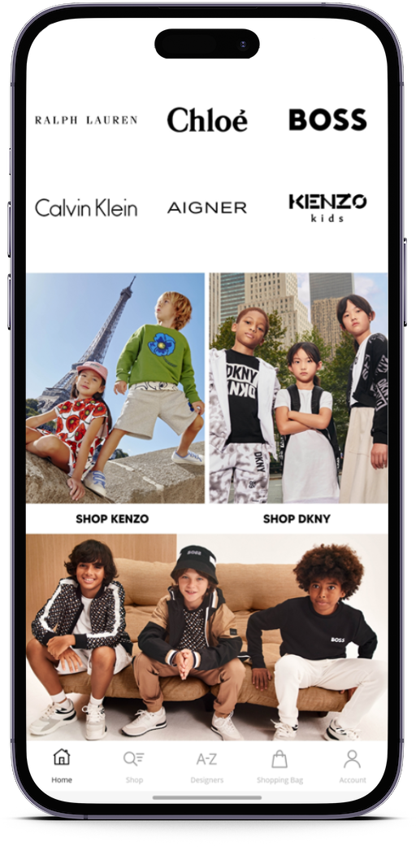
Maximize your brand’s mobile revenue

Slide 2
Agenda
Who we are
Why Big Brands push apps
How we work
How to get started

Slide 3
2008
Proprietary platform for custom app
Development launched
About JMango360
2015
SaaS platform developed
JMango360 is a technology company HQ in Amsterdam (NL) that enables online businesses and web agencies to build fully integrated native mobile applications for mobile commerce (iOS / Android) Through our Open SaaS platform we have delivered over 1.000 apps globally.
2016
Integration live
2017
Integration live
2018
Integration live
2019
Platform upgraded to Open SaaS
85 FTE
50 Development
1.000+
Apps deployed globally
2021
Integration live

Slide 4
Mobile has passed desktop
Source: Statcounter / Global stats
‘Mobile has become the dominant digital touchpoint, so businesses and professionals must elevate their mobile experiences to win, serve and retain loyal customers.’
Forrester

Slide 5
Mobile Commerce growing pains: Conversion
2021 Global E-commerce conversion rates | Mobile vs. Desktop
A few reasons behind the low conversion:
High expectations
Speed
Jumping from screen to screen
Scrolling and zooming
Payment process / Credit cards not stored
Source: smartinsights.com

Slide 6
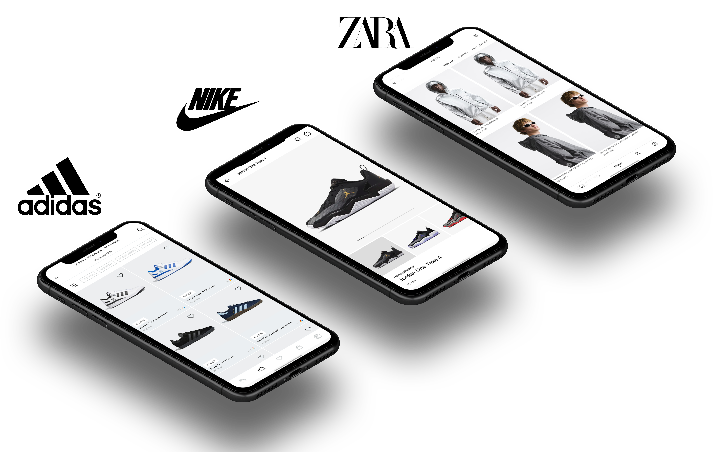
Big brands pushing their apps

Slide 7
This is why..
Conversion
x1,5
Research from Criteo shows that mobile apps are the best-converting channel in e-commerce, 3 times better than responsive websites.
x2
Mobile
responsive
website
Desktop
App
7

Slide 8
Options to improve mobile results
High
Extra traffic (Ads)
Optimization UX/UI
Native Custom App
Cost
Optimize checkout (PSP)
Mobile SEO
Speed
App as a Service
Low
Impact
High

Slide 9
Why JMango360?
01
02
03
04
OpenSaaS
Proven technology with the right building blocks that enables fast time to market
High end quality
Beautiful flexible design and innovative features. All you need to maximize mobile growth
One stop shop
Where others stop, we continue. Get strategic advice and app marketing support
Pay as you grow
Trusted by big brands
Affordable for everyone

Slide 10
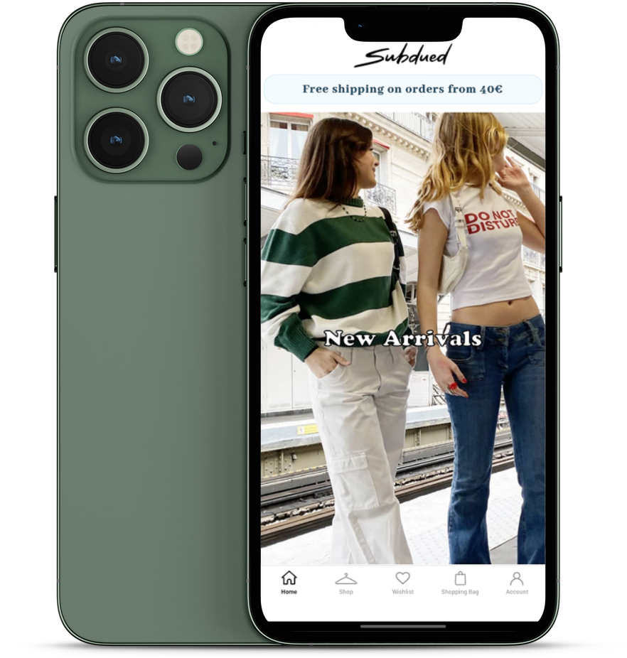
Fashion / apparel
Cosmetics
Sporting goods
Wine and spirits
Pet supplies
FMCG
Health & Medical
B2B
Sweet spot Verticals
Based on our experience we see that the following verticals are really successful with their native mobile solution.
An app for a company in these verticals is a ‘no brainer’.

Slide 11
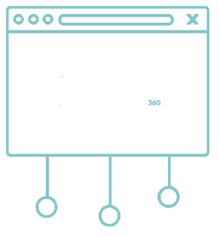
Fully integrated
With your E-commerce backend
Webstore
Customer
Products/Orders
APP
PWA
Products
Stock levels
Accounts
Shipping options
Payment options
JMango plug-in
E-Commerce
Back-end
JMango360
platform

Slide 12
Some of our 500+ customers

Slide 13
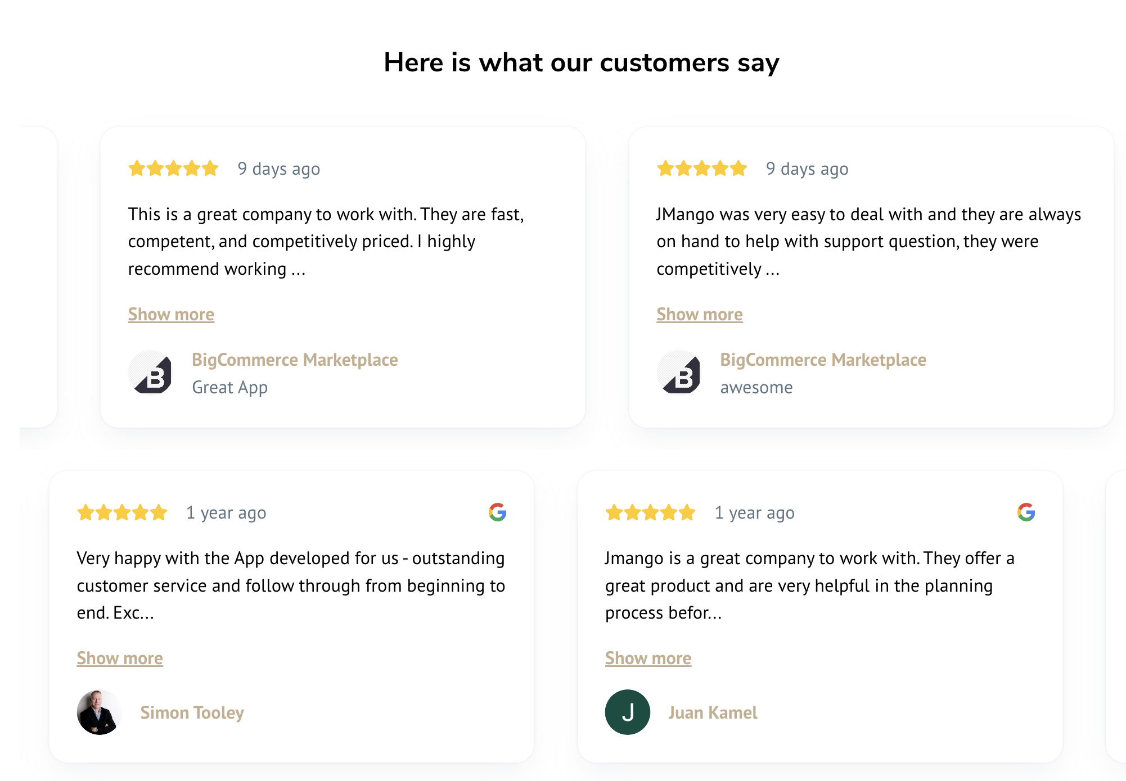
Happy clients sharing reviews

Slide 14
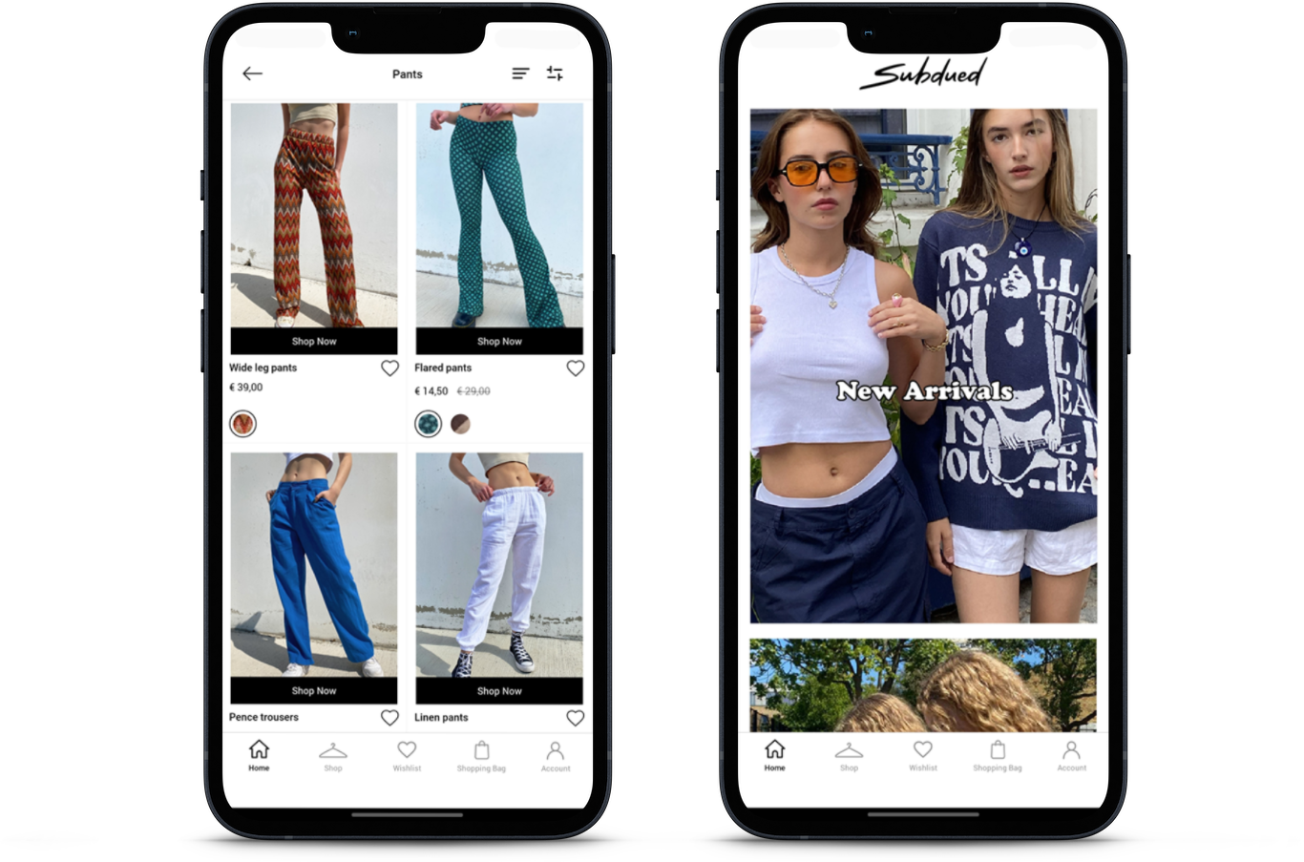
Case study: Subdued
Subdued is a brand for fun-loving, strong and independent teenagers. Founded in the 90’s in Italy, they have always aimed to bring something special to clothing making it unique and different from the mainstream. The design team is Italian and Italian heritage shines through in everything they do.
Results:
App launch March 2022
>440K downloads
Over 50% of total online revenue is now generated through the App
The best dev collab ever! ‘Our experience with JMango360 has been totally satisfying. All processes from on boarding to daily activities have been managed perfectly. The app launch and on going progress is now a growing success for our company.’
Sheida Ngo – CX & UX Manager Subdued

Slide 15
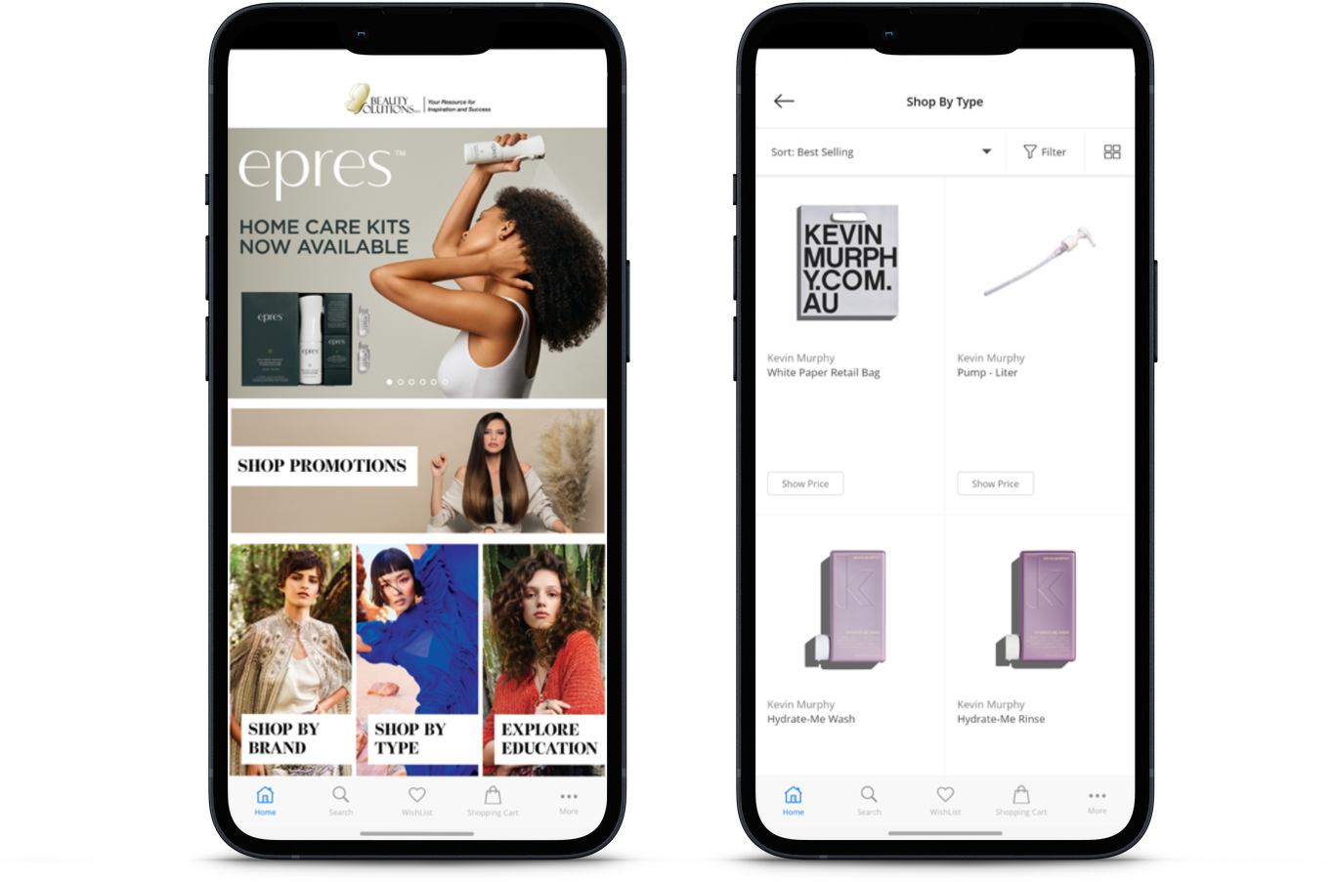
Case study: Beauty Solutions
Beauty Solutions, founded in 2007 with 9 locations in the US provides beauty professionals with the products, tools, and education they need to grow their business.
Results:
App launch December 2019
1.5X more repeat purchases
Custom features for shops/resellers
Client feedback ‘Our main objective is to activate customers through push notifications to pro-activtely
buy instead of current state of reactive. We are adding custom features to the app to make it completely fit to our customers.’
Shane Brown – Director of IT Beauty Solutions

Slide 16
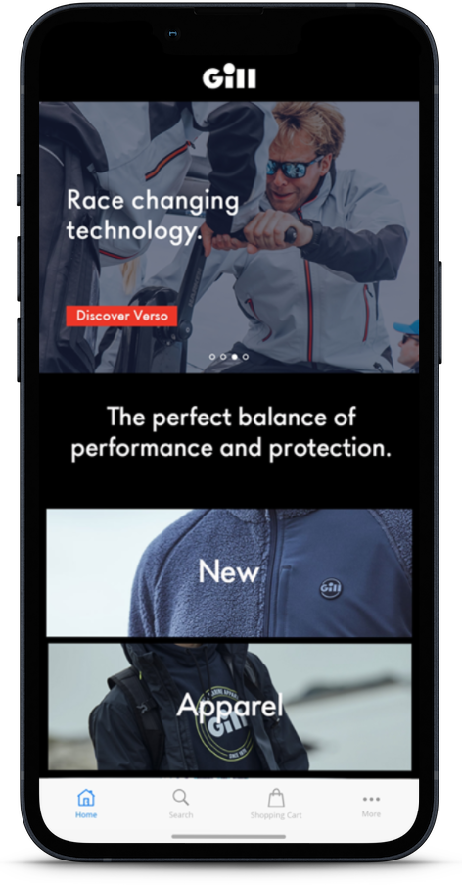
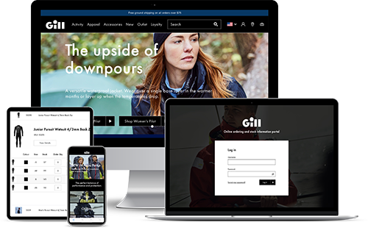
Case study: Gill Marine
Gill marine is a high-end Marine e-commerce brand and is known for its technical fabrics, innovative design, and attention to detail. The brand's products are designed to be durable, waterproof, and breathable, to provide protection from the elements while allowing freedom of movement.
‘Gill Marine asked JMango360 to assist in migrating our wholesale business from Magento to BigCommerce. We couldn’t be happier with the end result. JMango360 managed to surpass our expectations not only with regards to functionality but also with their support. The results have been great and I would recommend any B2B business, but wholesale especially to work with JMango360.’
Oliver Cole, Global Head of e-commerce
Results:
App launch May 2020
Average Order Value +28%
B2C & B2B

Slide 17
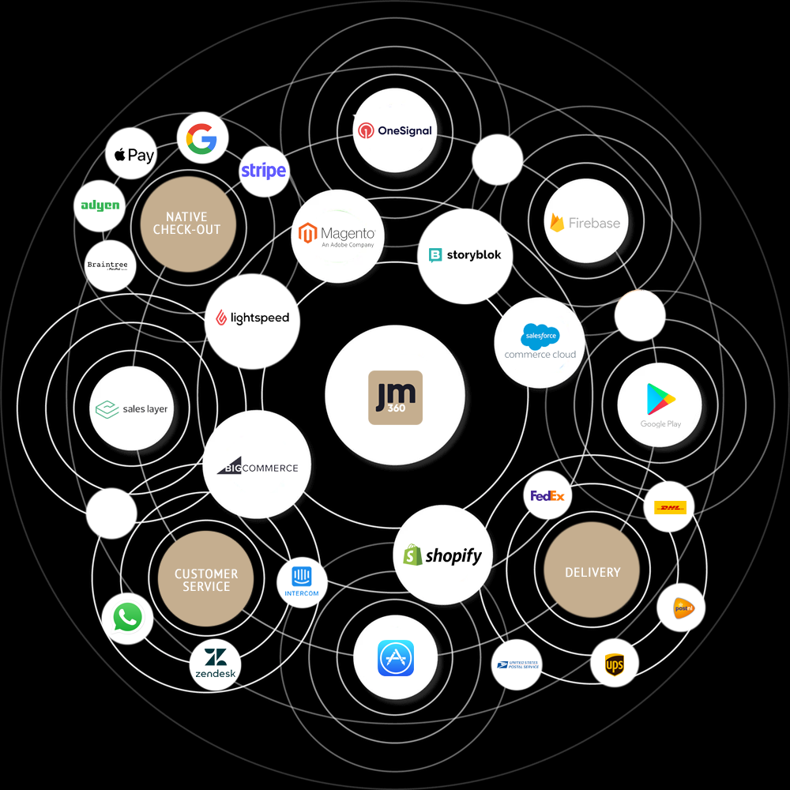
JMango360
Ecosystem
Flexibility in development and rapid time to market due to extensive network of existing integrations and partners.

Slide 18
Pay as you grow Pricing model enables flexibility
Essential
Advanced
Enterprise
Functionalities | Storeviews included | 1 | 2 | 3 or more
 | Checkout | Online | Online | Online or Native
 | Search | Standard | Standard | Elastic
 | Unlimited Push Notifications
 | Push Notification advanced
 | Analytics + Reporting
 | Firebase Analytics
 | Whatsapp integration
 | Product scanner
 | B2B functionalities
 | Customer groups
 | Universal linking
 | Premium Speed
Custom Development | Custom Development | Not Possible | Possible | Possible
Services | App Store Optimization | Essentials | Advanced | Advanced
 | Support | Online Working days | Online & phone Working days | Online & phone 7 days
 | App Marketing Assistance
 | Customer Success Manager | 3 months | ongoing | ongoing
Pricing based on :
Growth stage (12 months GMV)
Number of Store views
Features
Custom work
Essentials Growth Plan
Subscription as from USD 299 (Monthly)
+
Onboarding fee as from USD 2399
Advanced Growth Plan
Subscription as from USD 599 (Monthly)
+
Onboarding fee as from USD 3999
Enterprise Growth Plan
Upon request

Slide 19
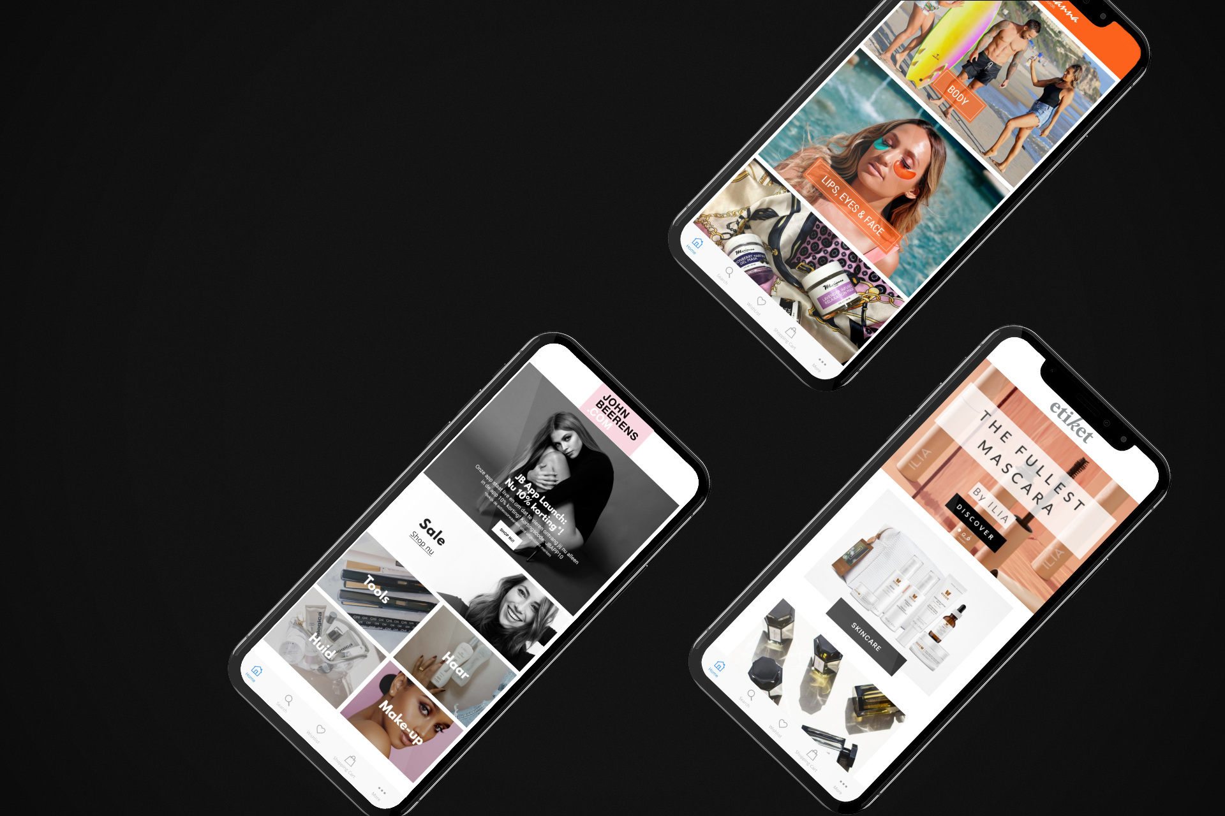
Time for a short demo
START DEMO

Slide 20
Next Steps?
Marco Alewijnse
marco@jmango360.com
+31612992370
Chief Commercial Officer
Maarten Schuiling
maarten@jmango360.com
+316 41375766
Chief Product Officer

